Slide 1
YOGA POSE RECOGNITION ALGORITHM
Deep Learning Project
Rathnapriya Gopalakrishnan, Akshya Ramesh, and Nina Groene

Slide 2
WHAT WE WILL COVER
Introduction
Datasets
Models built
Yoga Guru

Slide 3
INTRODUCTION

Slide 4
PROBLEM TACKLED
Accessibility to Yoga classes
Not getting personalized feedback
Our model will allow the user to get feedback from a CNN Classification model
Notes:
Since we have limited yoga classes and the ones that are available are very expensive, our aim to build a model that can recognize yoga poses.
So we plan on building an interactive application where our model can help users get feedback on their poses.
So our model can tell them if they are doing the pose correct or not and give them suggestions when needed.

Slide 5
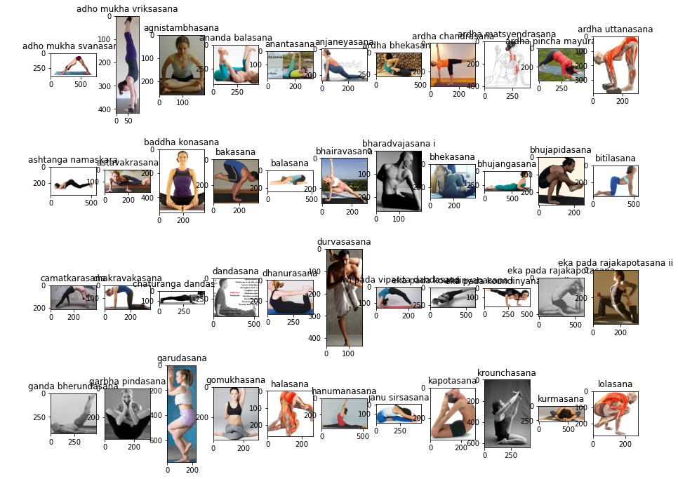
DATASET - 1
‘Yoga Pose Image Classification Dataset’
107 of asanas
Different people, outfits, and backgrounds
Notes:
107 - Asanas and
around 3k - images of different people with different angles and different positions.

Slide 6
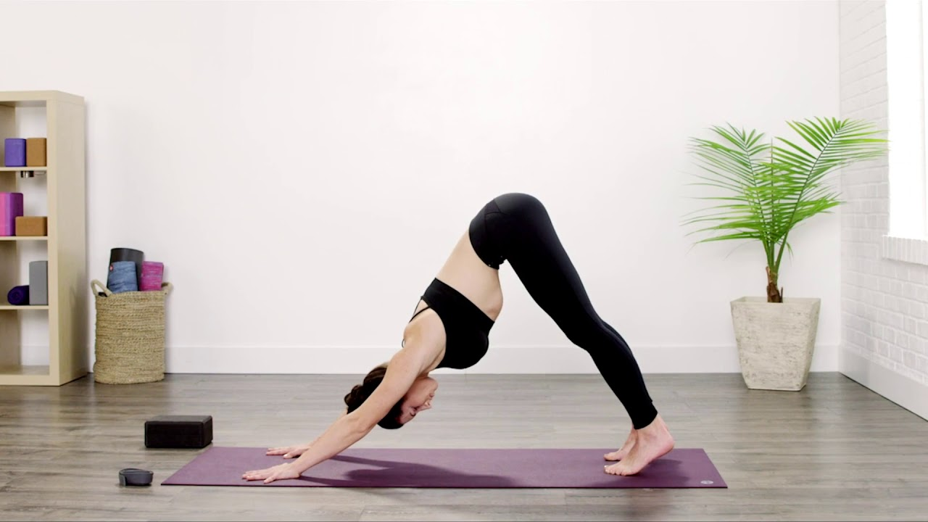
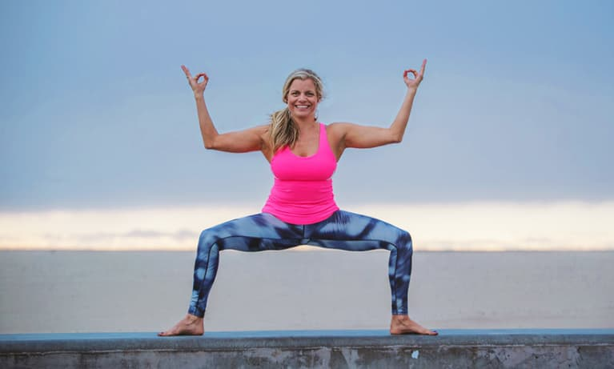
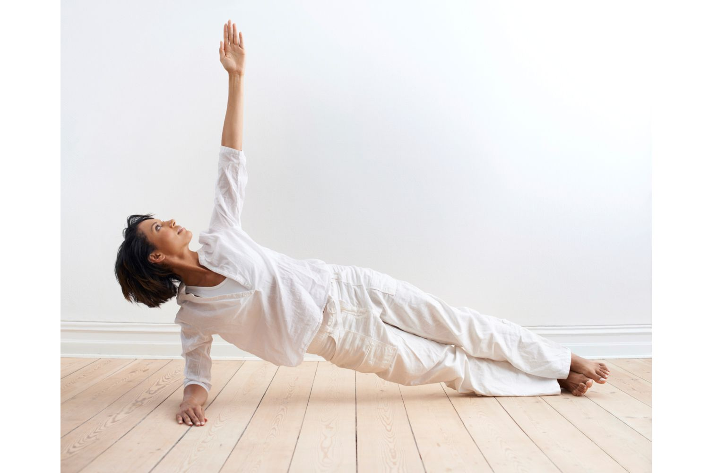
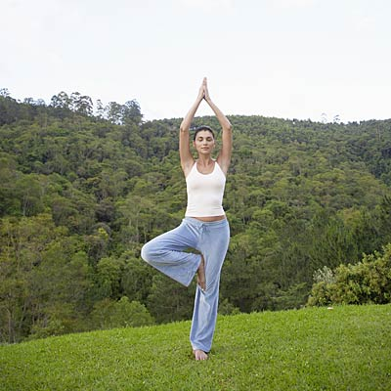
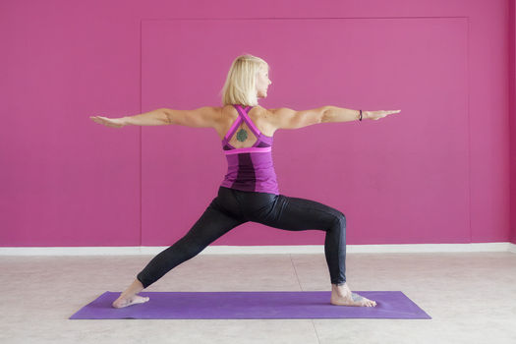
DATASET - 2
‘Yoga Pose Dataset’ from Kaggle
5 asanas - downdog, goddess, plank, tree, warrior 2
Contains 1500 images
Notes:
107 - Asanas and
around 3k - images of different people with different angles and different positions.

Slide 7
Summary:
Data Preprocessing

Slide 8
DATA PREPROCESSING
Removing unwanted image file formats
Image Resizing
Conversion to Grayscale
Numpy Arrays
Normalizing
Labelling and Encoding
Data Augmentation for minority classes

Slide 9
Model 1

Slide 10
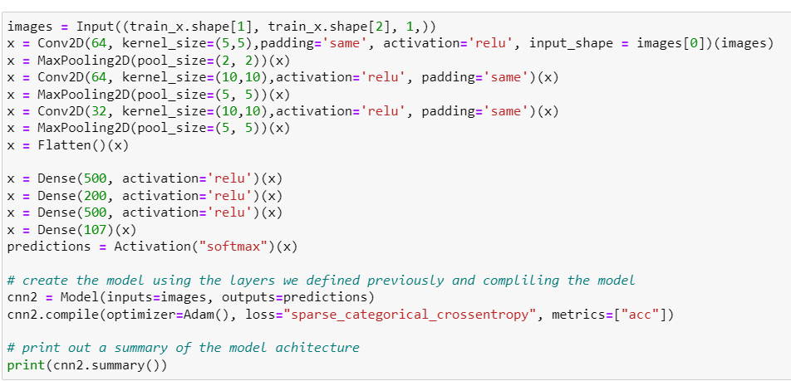
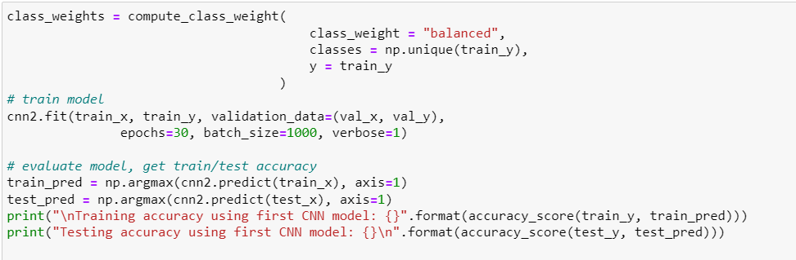
Training Accuracy: 0.77
Test Accuracy: 0.37

Slide 11
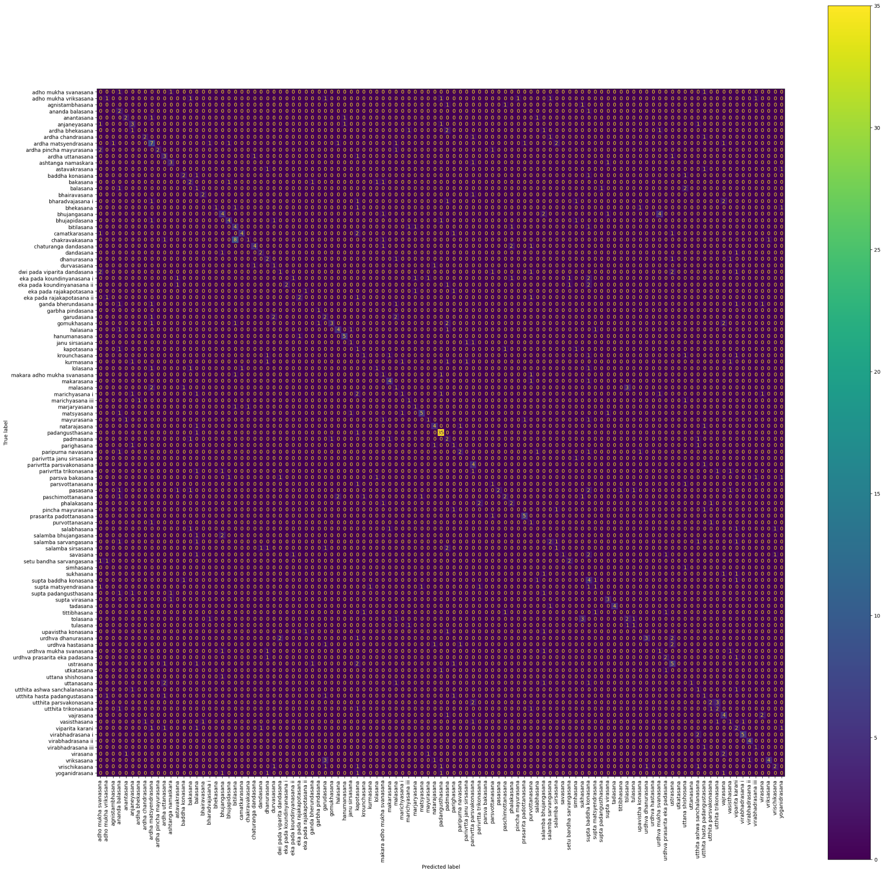
Confusion Matrix

Slide 12
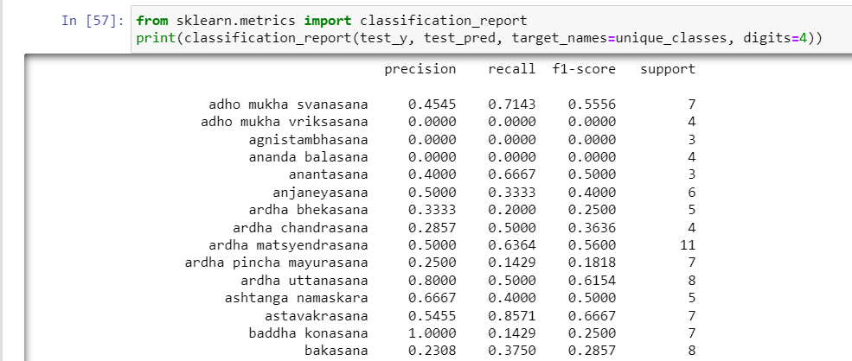
Classification Report
Precision:
Baddha Konasana: 1
Garudasana, Gomukhasana, Ardha Uttanasana: 0.8

Slide 13
Model 2
Basic 25 Yoga Asanas Model

Slide 14
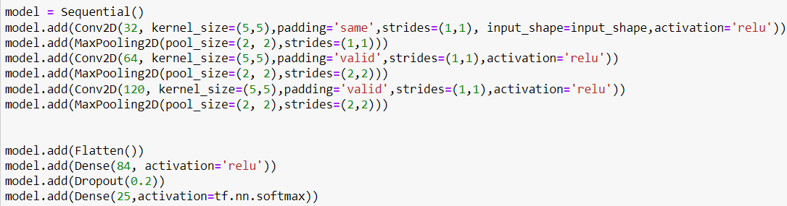
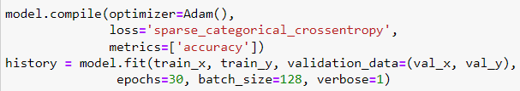
Training Accuracy: 0.99
Test Accuracy: 0.62

Slide 15
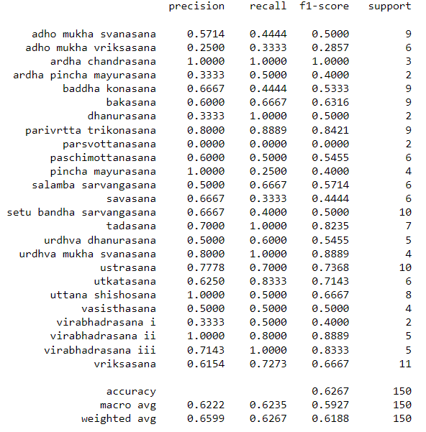
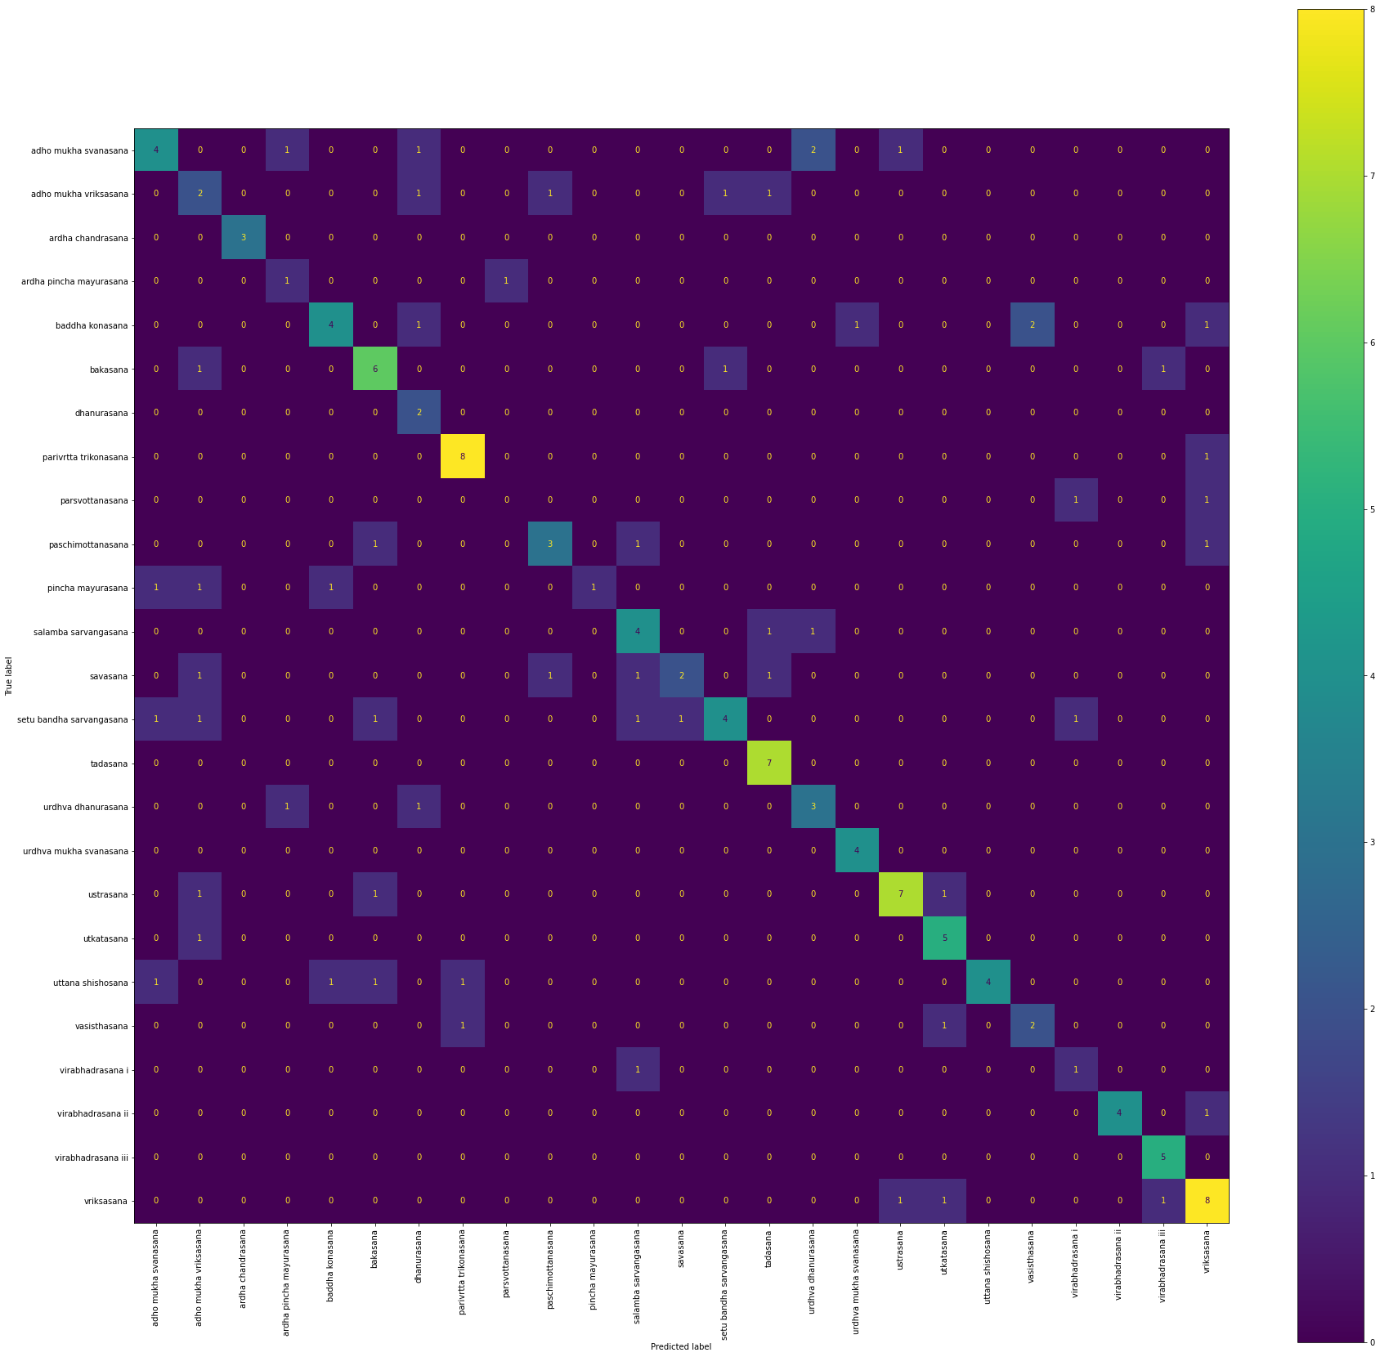
Evaluation
Precision: 1.0
ardha chandrasana
pincha mayurasana
uttana shishosana
virabhadrasana ii

Slide 16
Yoga Guru -
Using 25 Asana

Slide 17
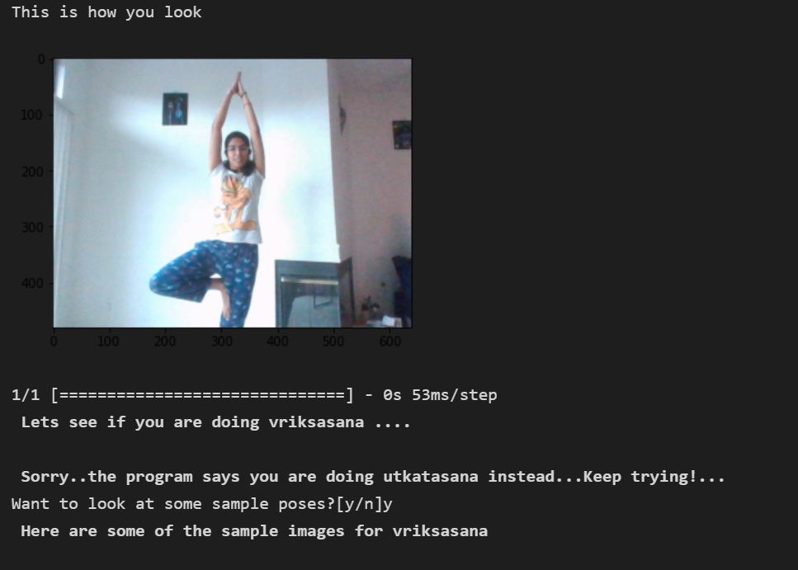
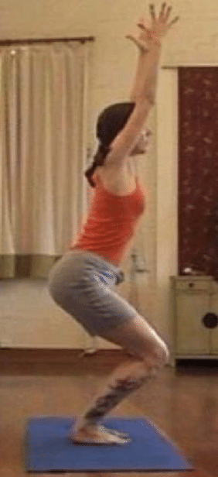
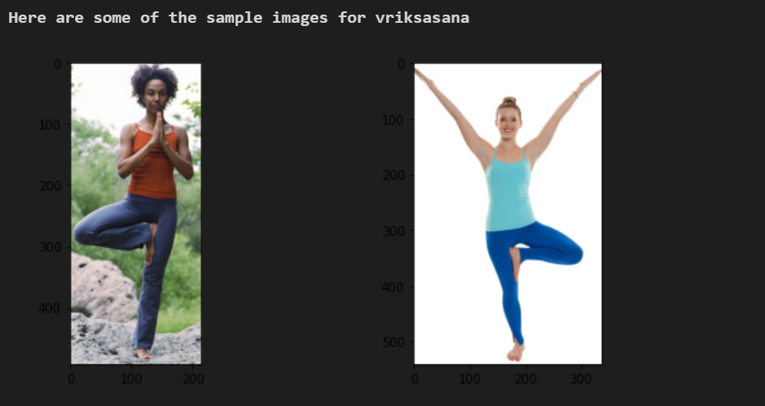
utkatasana

Slide 18
Model 3
Using Dataset 2

Slide 19
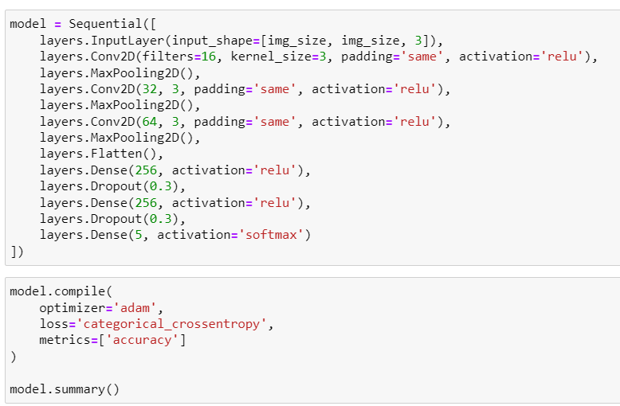
Training Accuracy: 0.95
Test Accuracy: 0.91

Slide 20
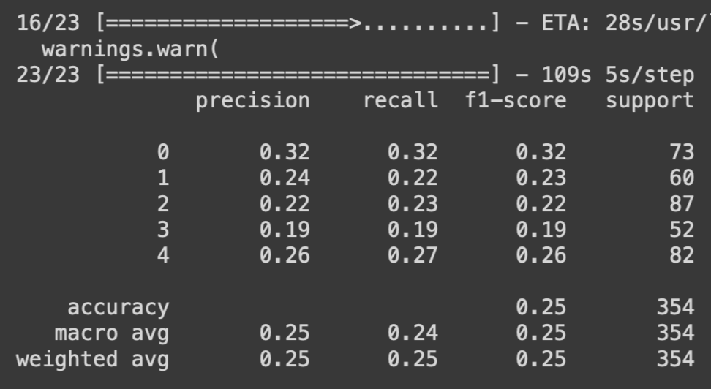
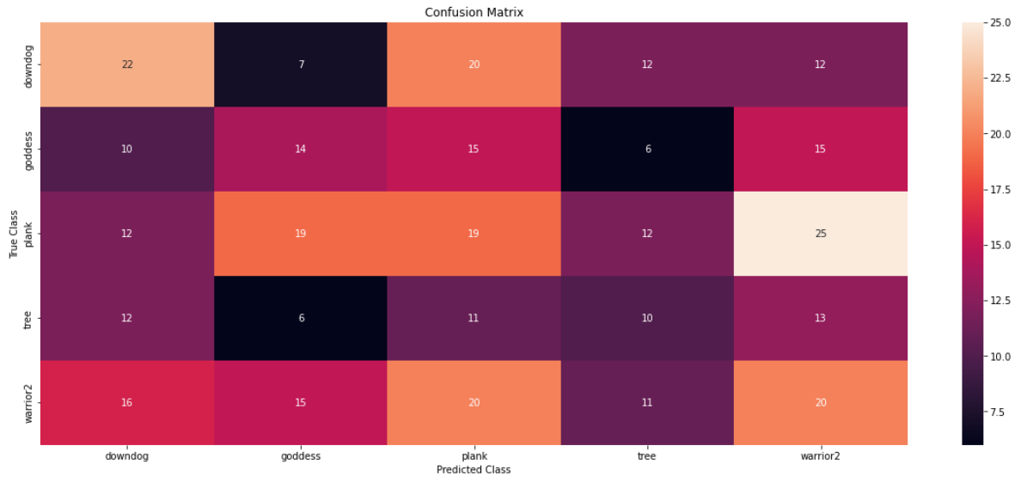
Report
Confusion Matrix

Slide 21
Yoga Guru -
Using 5 Asana

Slide 22
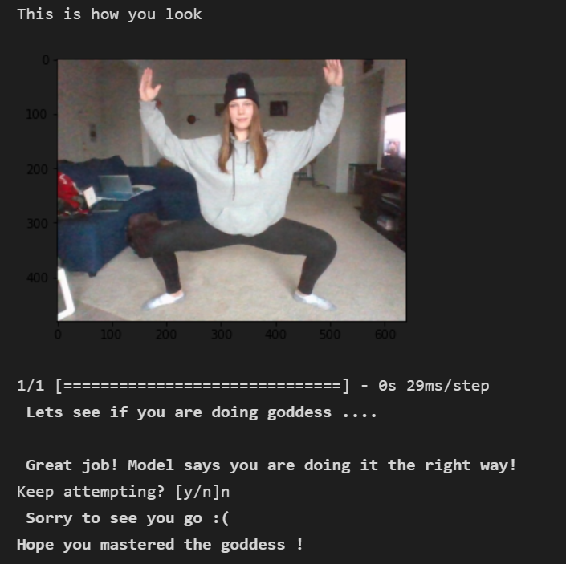
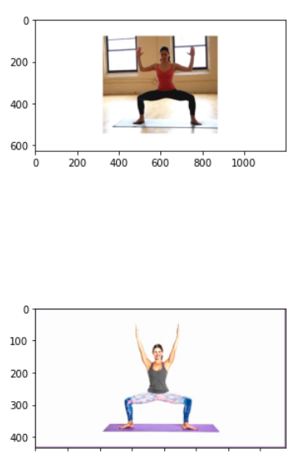

Slide 23
Model 4:
Transfer Learning Approach

Slide 24
Short Transfer Learning Intro
Reuse of pre-trained model on new problem
Neural Networks: tries to detect edges in early layers, shapes in the middle and specific features in the later layers
Transfer Learning: the early and middle layers are used and only retraining the latter layers
Why? - It helps leverage the labeled data of the initially trained task
Notes:
Example: Model trained to recognize groupings in crowds or overall crowd movement:
the model learned to recognize humans
Because of that we will only retrain the latter layers so it will learn the difference in poses (this case yoga poses)

Slide 25
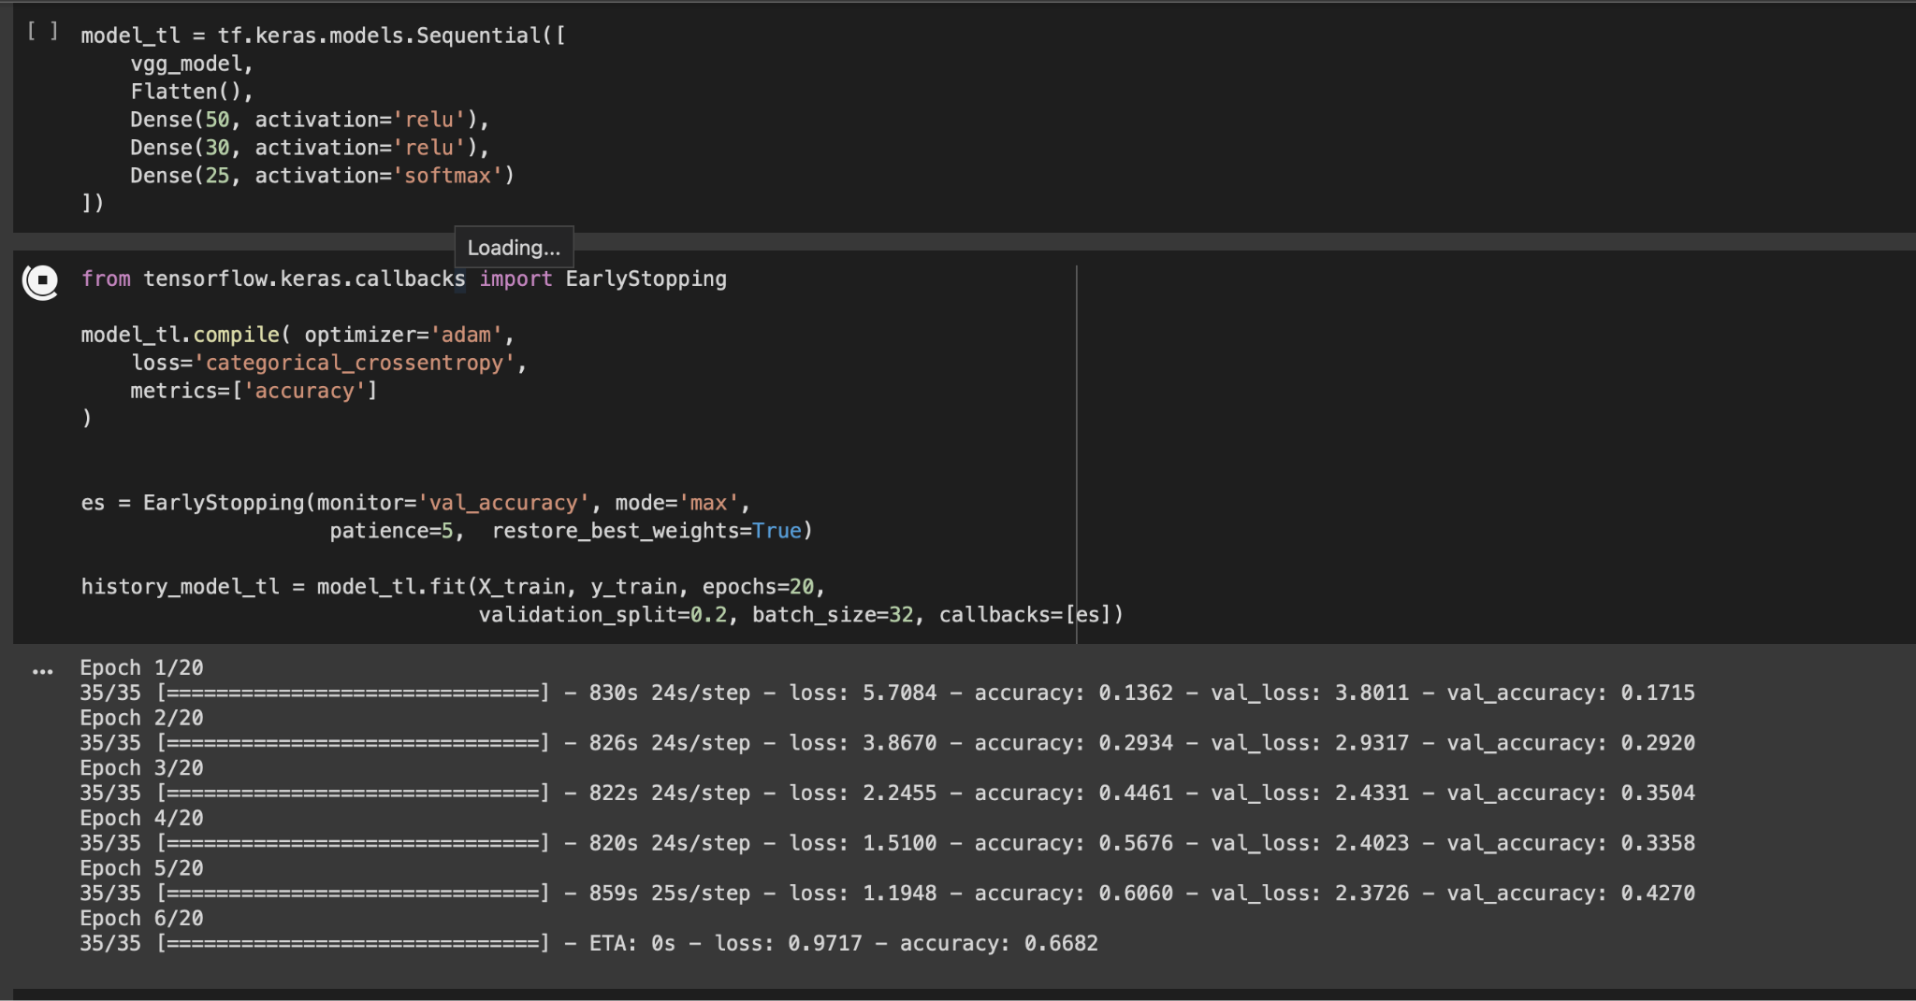

Slide 26
Further steps
Complete Transfer Model (In Progress)
Improve Dataset 2 model (In Progress)
Implement People Segmentation for User Functionality (In Progress)
Improve feedback of Yoga Guru
Give feedback rather than printing out positive examples
Improve our 107 asana model with more data better approach
Design models for different categories of poses
Link to Github: https://github.com/AkshyaRamesh21/YogaGuru_DL

Slide 27
Questions?

Slide 28
Thank you!

